Slide 1

Marie-Anne Vedy-Zecchini,
Antsa Rafenomanjato
Parameters optimization
Modelling the impact of climate change on primary inoculum production of Leptosphaeria maculans
5th ENDURE Summer School ‘The role of IPM in mitigating effects of climate change on pest dynamics – modelling approaches’

Slide 2
Modelling the impact of climate change on primary inoculum production of Leptosphaeria maculans
Introduction:
  Correlation between observed and predicted data
Material and methods
  Statistical criteria to be optimized
  The function optim
Results
Discussion:
  Computational method to minimize statistical criteria
  Which algorithm should be used?

Slide 3
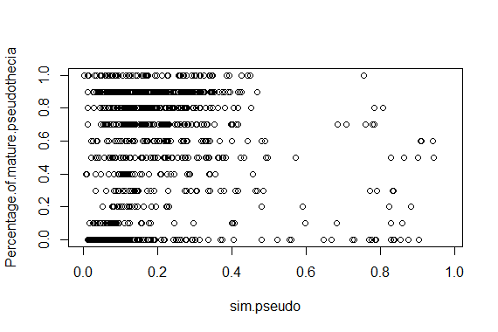
Introduction
Correlation between observed and predicted data

Slide 4
Introduction
Correlation between observed and predicted data
Objectives of the parameters optimization:
modify the value of the parameters to change the model outputs and increase the correlation.
What values will adopt parameters?

Slide 5
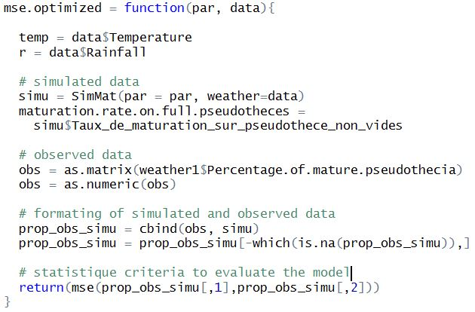

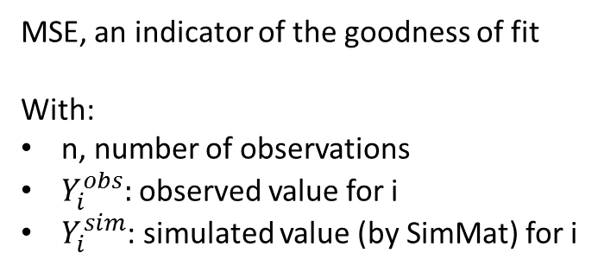
Material and methods
Statistical criteria to be optimized
MSE $=\frac{1}{n} \sum_{i=1}^{i=n}{{(Y_{i}^{obs} −Y_{i}^{sim})}^{2} }$
MSE, an indicator of the goodness of fit
With:
n, number of observations
$Y_{i}^{obs}:$observed value for i
$Y_{i}^{sim}$: simulated value (by SimMat) for i

Slide 6
Material and methods
The function optim
The more flexible
Without linear constraint of variables

Slide 7
Material and methods
The function optim
Initial values of parameters:
θ_{max} = 22°C (Salam et al., 2003)
θ_{min} = 6°C (Salam et al., submitted)
- r_{min} = 4 mm (Salam et al., 2003)
n_{d} = 7 days (Salam et al., 2003)
N_{FD} = 65 days (Aubertot et al., 2005)
σ_{FD} = 24 days (Aubertot et al., 2005)
- k = 4.6 10⁻² mm⁻¹ (P_{EP}=.99 after r=100 mm)

Slide 8

Material and methods
The function optim
Initial values of parameters
The statistical criterion to be optimized:
MSE $=\frac{1}{n} \sum_{i=1}^{i=n}{{(Y_{i}^{obs} −Y_{i}^{sim})}^{2} }$

Slide 9
Material and methods
The function optim
Initial values of parameters
The statistical criterion to be optimized
The method used by function:
With bound constraints for parameters

Slide 10
Material and methods
The function optim
Initial values of parameters
The statistical criterion to be optimized
The method used by function
Bounds of parameters

Slide 11
Material and methods
The function optim
Initial values of parameters
The statistical criterion to be optimized
The method used by function
Bounds of parameters
Data used for criterion:
Data which come from Poznan in 1991

Slide 12

Results
New parameters found by the function optim:
θ_{max} =
θ_{min} =
r_{min} =
n_{d} =
N_{FD} =
σ_{FD} =
- k =
In progress …

Slide 13
Discussion
Computational methods to minimize statistical criteria
Other methods:
Algorithms provided by NAG C library (Numerical Algorithms Group®): which one should be used?

Slide 14
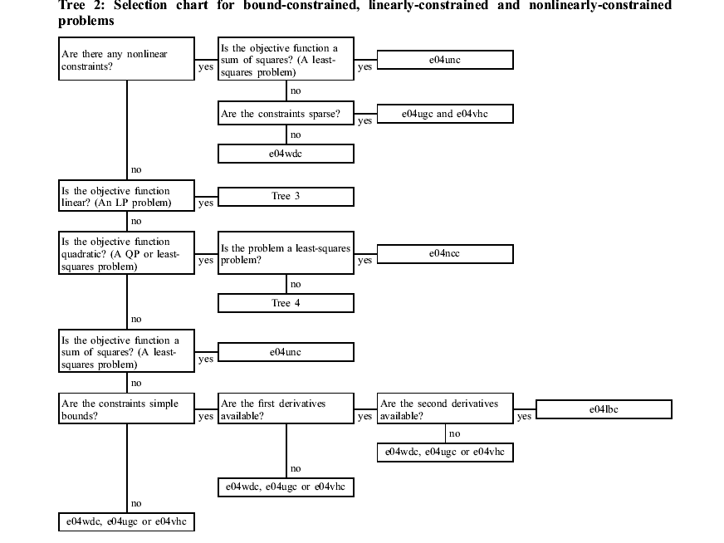

Slide 15
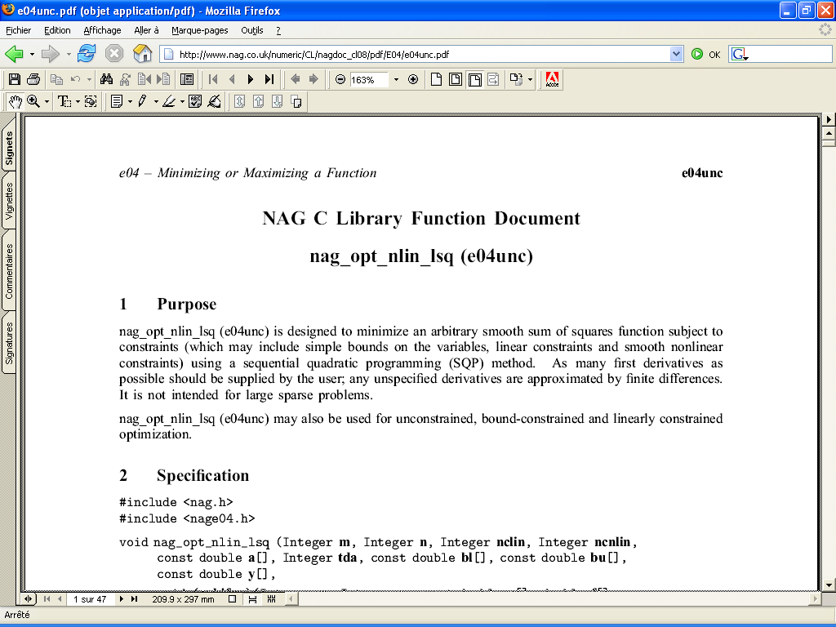
Discussion
Computational methods to minimize statistical criteria

Slide 16
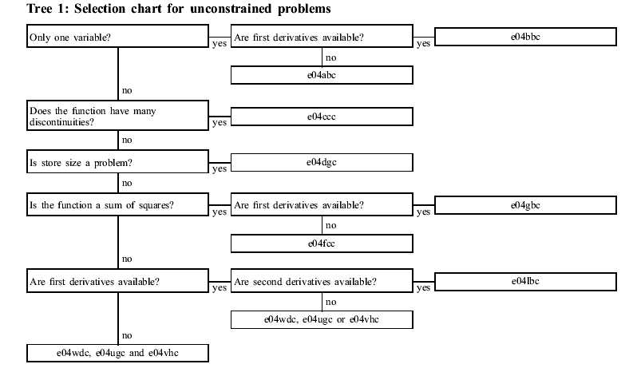
Discussion
Which algorithm should be used?

Slide 17
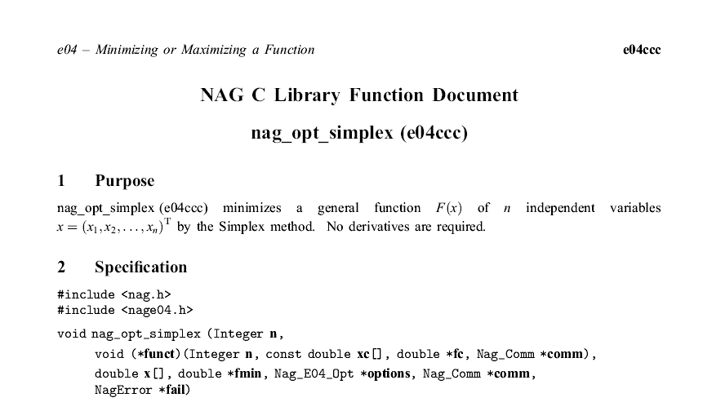
Discussion
Which algorithm should be used?
Finally, need to evaluate the goodness of fit with new values of parameters

Slide 18

Thank you

